Slide 1
Qsan AegisSAN Series Technical Introduction

Slide 2
Topics
AegisSAN Series Introduction
System Architecture
Enterprise Software Features
Optimized Performance
Applications
AegisSAN Series Value and Benefits

Slide 3
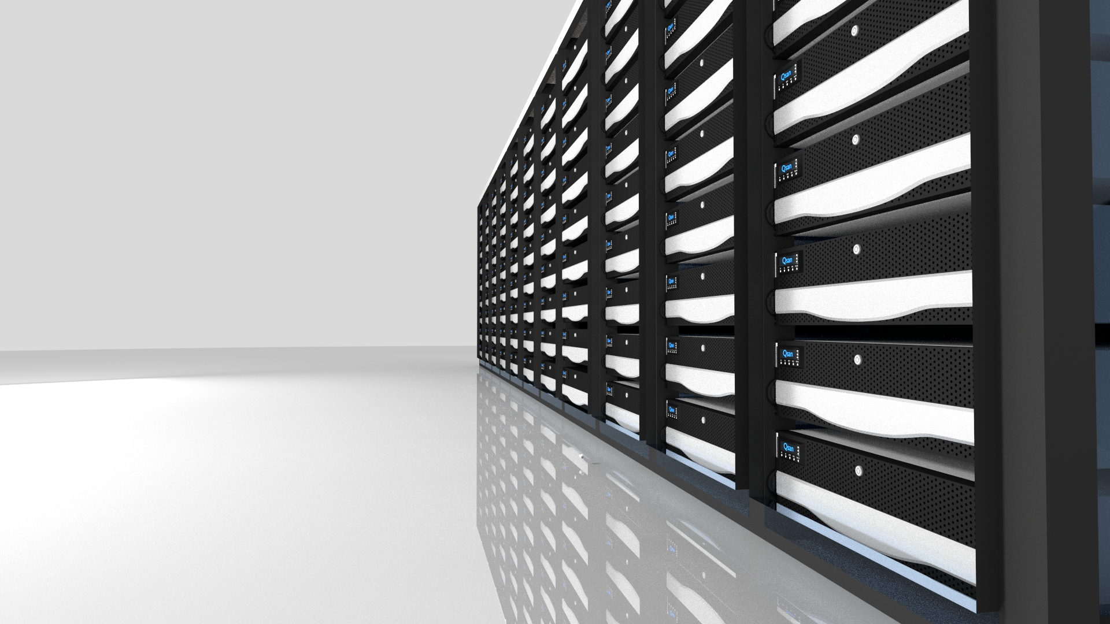
AegisSAN Series

Slide 4
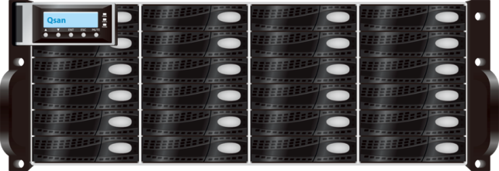
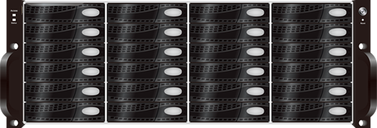
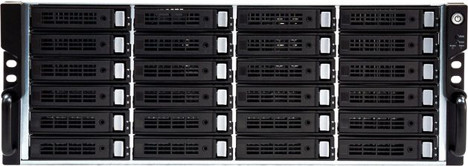
AegisSAN LX, Q500, V100 SAN Series
AegisSAN LX
AegisSAN Q500
AegisSAN V100
Reliable, Modest, Simple, and Efficient.

Slide 5
Marketing Positioning
AegisSAN LX
High performance enterprise-class storage systems designed for HPC, Media, and Virtualization environments.
AegisSAN Q500
High reliability storage systems optimized for throughput and designed for SMB.
AegisSAN V100
Lowest TCO storage systems designed for Surveillance, Backup, and IT Applications.

Slide 6
Specifications
AegisSAN
LX
AegisSAN
Q500
AegisSAN
V100
10G iSCSI | 1G iSCSI | 16G FC | 8G FC | 10G iSCSI | 1G iSCSI | 16G FC | 8G FC | 10G iSCSI | 1G iSCSI | 8G FC
2U12 | 3U16 | 4U24 | 4U60 | 2U12 | 3U16 | 4U24 | 3U16 | 4U24
Max 256 HDD | Max 256 HDD | Max 192 HDD
Max Enclosures No. 21x 2U12 | 16x 3U16 | 10x 4U24 | 4x 4U60 | Max Enclosures No. 21x 2U12 | 16x 3U16 | 10x 4U24 | Max Enclosures No. 16x 3U16 | 10x 4U24
Integral Data Protections Snapshot | Clone | Replication | Integral Data Protections Snapshot | Clone | Replication | Integral Data Protections Snapshot | Clone | Replication
Smart Data Management Thin Provisioning | SSD caching Fast rebuild | Seamless Roaming | Copy Migration | Smart Data Management Thin Provisioning | SSD caching Fast rebuild | Seamless Roaming | Copy Migration | Smart Data Management Thin Provisioning | SSD caching Fast rebuild | Seamless Roaming | Copy Migration
Dual Active
Controllers
Dual Active
Controllers
Single
Controller
1.5PB
1.5PB
1.1PB

Slide 7
System Architecture

Slide 8
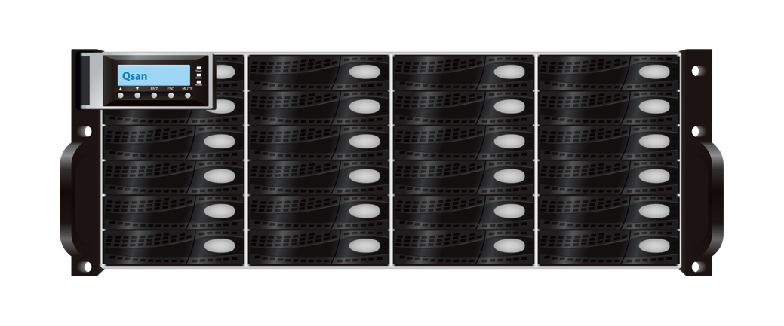
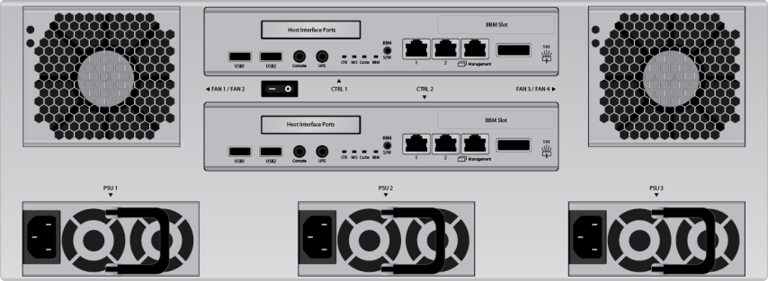
AegisSAN LX/Q500 HW Architecture
Top View
Front View
12~60
HDD/SSD
PSU
Controller 1
Controller 2
Rear View
Fan
Mid-Plane
SBB 2.0 Compliant
Notes:
SBB 2.0 -> Storage Bridge Bay

Slide 9
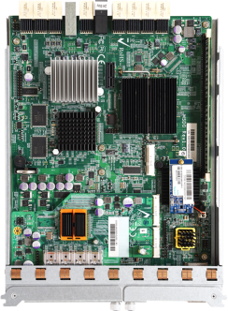
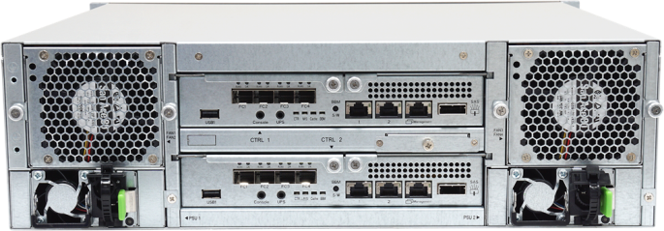
Fully Redundant Components
All components in the system are designed with redundancy.
RAID controllers
PSUs
Fans
Data & disk paths

Slide 10
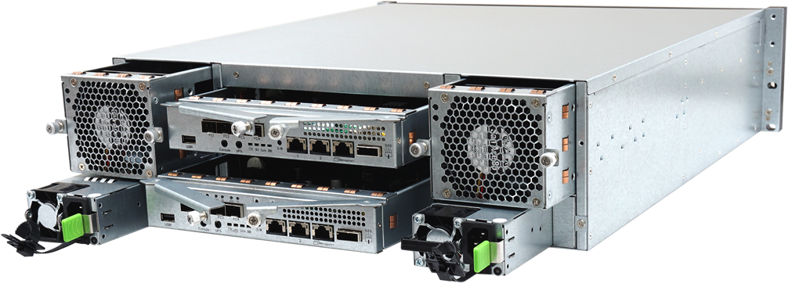
Hot Pluggable Modular Design
All major units are customer replaceable units
Efficient replacement process
All hot swappable CRU
Hard drive trays
RAID controllers
PSUs
Fans

Slide 11
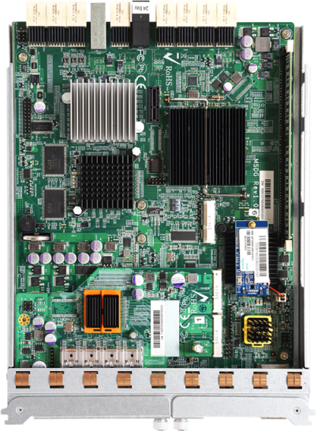
Active-Active RAID Controllers
Active-Active
Completely support each other
Double the performance
Failover in seconds
IO takeover in seconds
Hot swappable
Hello ☺
Hello ☺

Slide 12
AegisSAN LX/Q500 RAID Controller
Mid-Plane
Dual Core CPU
PCIe
Switch
iSCSI & FC Offload Engine
HA Function
Hardware RAID Engine
CPU Built in
SAS Expansion
6G SAS IO Controller
IO Chip
10G iSCSI
1G iSCSI
16G FC
8G FC
High Availability
Fully Redundant HW Components
6G SAS
Channel x24
6G SAS Expander
High IOPS & Throughput
Boost performance from bottom (HW) to top (FW)
RAID Controller

Slide 13
Automatic Failover
When a RAID controller fails
All the IO are mirrored
The 2nd RAID controller will take over immediately
On going IO
Current sessions
Service ownership
Identities to the host
Multipath
1
2
•
•
•
•
•
•
•
•
•
•
•
•
•
•
•
•

Slide 14
Automatic Management Failover
When the master RAID controller fails
The management service is automatic failover to the other RAID controller w/o any user intervention.
192.168.10.123
What just
happened?
・_・?

Slide 15
Non-Disruptive Upgrade
Service nonstop
No system downtime
Automatic firmware synchronization
RAID
Controller 1
RAID
Controller 2
C2 IO /
Sessions
C1 IO /
Session
C1 IO /
Sessions
C2 IO /
Session
Upgrading…
Upgrading…
1
2
•
•
•
•
•
•
•
•
•
•
•
•
•
•
•
•

Slide 16
Cache Mirroring
Hello ☺
Hello ☺
Always mirror incoming IO to another RAID controller
Minimize data loss chance
01001000
01100101
01101100
01101100
01101111
01001000
01100101
01101100
01101100
01101111
01001000
01100101
01101100
01101100
01101111

Slide 17
Cache Protections
Battery Backup Module
Copy-to-Flash Module (C2F)
72 Hours
Restore data right after power restoration
Minimized data lost change to power outage
∞ Hours
Restore data right after power restoration
Zero data lost chance to power outage
Provide individual battery power to the memory.
Store memory data in non-volatile flash storage.

Slide 18
No Single Point of Failure
≠
Redundancy Eliminating Failure
From Redundancy to Uptime
Out-and-Out Design
Integral Installation

Slide 19
Qsan Storage Management Structure
Proprietary
High Availability
Linux Kernel
Controller 1
High
Controller 2
High
User Interface Module
RAID Management Module
User Interface Module
RAID Management Module
RAID Groups
Thin Provisioning
……
Http
Https
SSH
Console
API
Availability
Enclosure
Management Module
Logical Volume Module
Availability
Enclosure
Management Module
Logical Volume Module
Snapshots
Volume Cloning
Replication ……
Cluster
IO
Module
Data
(SCSI)
Module
Cluster
IO
Module
Data
(SCSI)
Module
Host
Data
Traffic

Slide 20
Hardware Multipath
Qsan storage system hardware is designed w/ higher availability and Dual Paths between head and expansion units.
Mid-Plane
RAID
Controller 1
RAID
Controller 2
SAS x4
Expansion
Port
Service Nonstop
JBOD
Controller 1
JBOD
Controller 2
HDD 1
HDD 2
………………
HDD X

Slide 21
High Availability Installation Requirements
Cluster, Virtualization, Nodes……
Fully redundancy of every component
Server, backup servers
Switch, backup switches
Storage, backup storages
Multiple paths
Multiple data protections
Local
Remote
Disaster Recovery
Branch Office
Remote Replication
For DR
•
•
•
•
Multipath, MPIO, MCS, Trunking, LACP……
•
•
•
•
•
•
•
•
•
•
•
•
Remote
Replication
•
•
•
•
•
•
•
•
•
•
•
•
•
•
•
•
•
•
•
•
•
•
•
•
•
•
•
•
•
•
•
•
RAID, Snapshot, Clone……

Slide 22
Qsan High Availability Solution
Hardware
SANSoft
No single point of failure
Fully redundant components
Active-Active RAID controllers
Hot pluggable modular design
Cache mirroring
Automatic failover
Automatic management failover
Non-Disruptive upgrade
5 Minutes Downtime Per Year
99.999% Uptime

Slide 23
Hard Drive Compatibility & Expansion
Hard Drive Compatibility
Expansion
Provide Up-to-Date hard drive compatibility list
No hard drive bundle purchase with any Qsan storage systems
Comprehensive Hard Drive List – SAS, NL SAS, SATA, SSD
Up to 20 expansion units
Max 256 HDD @ LX | Q500
Max 192 HDD @ V100
Mix drive types support within an enclosure
Mix enclosure types per system – 2U12, 3U16, 4U24, 4U60

Slide 24
Enterprise Features
Enterprise Software Features
Integral Data Protections
Snapshot | Clone | Replication
Smart Data Management
Thin Provisioning
SSD caching
Fast rebuild
Seamless Roaming
Copy Migration

Slide 25
AegisSAN Enterprise Software Feature
Storage Volumes
Standard | Thin Provisioning
Data Protections
Data Management
System Configurations
System Management
Interface & Networking
MPIO, MC/S, Trunking, LACP, VLAN
Operating System & Compatibility
Virtualization

Slide 26
Standard SAN Storage Volumes
Logical Unit
Identity of a virtual disk
Virtual Disk
Partial or all space of a RAID group
RAID Group
0, 1, 0+1, 3, 5, 6, 10, 50, 60
Server
LUN
0
LUN
1
LUN
2
LUN
3
LUN
4
Logical Unit
Virtual Disk
RAID Group
Hard Drive
•
•
•
•
System Enclosure
•
•
•
•
•
•
•
•
•
•
•
•

Slide 27
Thin Provisioning Storage Volumes
Logical Unit
Identity of a virtual disk
Virtual Disk
Partial or all space of a RAID group
Thin Provisioning RAID Group Set
0, 1, 0+1, 3, 5, 6, 10, 50, 60
Server
LUN
0
LUN
1
LUN
2
LUN
3
LUN
4
Logical Unit
Auto Expand
Virtual Disk
Thin Provisioning
RAID Group
Run Out of Space
Add a RAID Group
Hard Drive
•
•
•
•
System Enclosure
•
•
•
•
•
•
•
•
•
•
•
•

Slide 28
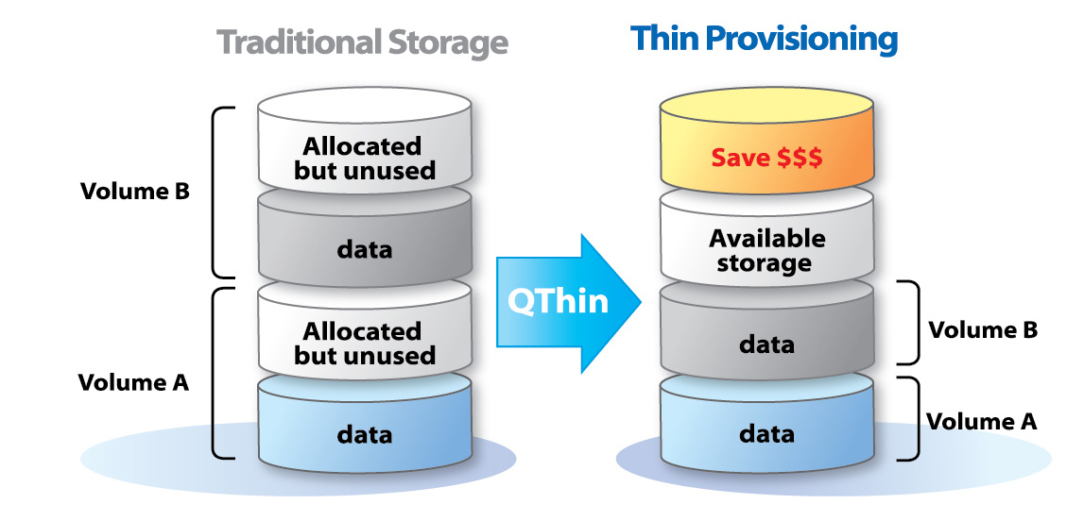
Thin Provisioning Advantages
Reduce allocated but unused capacity
Maximize storage utilization
Enhance data efficiency of IT infrastructure
Lower TCO

Slide 29
DAS vs. SAN | Thin Provisioning
DAS
Separate storage & management
Insufficient use of capacity
Challenges at data protection and availability
Complexity at expanding capacity
SAN | Thin Provisioning
Centralized storage & management
Efficient use of capacity
Centralized backup, data protection & high availability
Centralized & reduced unused capacity
New Server?
New HBA?
New DAS?
SQL
Server
Exchange
Server
Application
Server
……
•
•
•
•
•
•
•
•
•
•
•
•
•
•
•
•

Slide 30
Standard SAN
Thin Provisioning
Strength
Strength
Performance
Continuous Data Structure
Expansion Flexibility
Instant Expansion Instead of RAID Migration
23% Faster
18% Faster
Auto Expand
Run Out of Space
Add a RAID Group
Add another RAID Group

Slide 31
Data Protection - Why Backup?
These could happen
Hard drive fails
Virus attacks
File system crashes
Unexpected power outage
Unknown outages
Natural disasters
……

Slide 32
Qsan Built-in Data Protections
Array-based built-in
Multipath & failover
No extra software fee or installation
Support 3rd party backup software
Integral Data Protections
Writeable Snapshot
Volume Cloning
Remote Replication
Snapshot
Volume Cloning
Remote Replication
Notes:
**** no performance impact -> removed

Slide 33
Data Protection Planning
>
Multipath
Branch Office
Remote Replication
For DR
Snapshot
Snapshot
•
•
•
•
Remote Replication
∨
•
•
•
•
•
•
•
•
>
<
•
•
•
•
Snapshot
Snapshot
Snapshot
Branch/Datacenter A
Clone
Snapshot
Snapshot
Snapshot
•
•
•
•
•
•
•
•
•
•
•
•
•
•
•
•
•
•
•
•
•
•
•
•
•
•
•
•
•
•
•
•
Clone
Building A
Building B
•
•
•
•
Headquarter / Datacenters
•
•
•
•
•
•
•
•
•
•
•
•
Branch/Datacenter B

Slide 34
Painless Data Management
When the original storage planning / configuration doesn’t fit anymore. You want
Different RAID level protection for the data
Bigger hard drives replacing dying ones
Faster host interfaces for current data
Change 1G iSCSI system to 10G iSCSI, 8G to 16G FC

Slide 35
RAID Level Migration
RAID 0
Support migration to any RAID level*
E.g.
RAID 0 to 5
RAID 5 to 6
RAID 6 to 10/50/60
RAID 5
RAID 6
RAID 60
* Downgrade is supported but not recommended.

Slide 36
10TB Hard Drive is Coming!
While other vendors suggest rebuilding disk by disk in high risk.
Qsan supports Moving Migration
Copy (Move) all the data to new bigger RAID group without stopping any IO.
10TB
1TB
10TB
10TB
10TB
1TB
1TB
1TB
01001000
01100101
01101100
01101100
01101111
01001000
01100101
01101100
01101100
01101111
01001000
01100101
01101100
01101100
01101111
1TB
1TB
1TB
1TB
10TB
10TB
10TB
10TB

Slide 37
RAID Group Roaming
Easiest storage system upgrade without worrying about the data
“3” steps only
Stop IO
Offline the RAID Group*
Move the disks
1G iSCSI Storage
•
•
•
•
•
•
•
•
•
•
•
•
•
•
•
•
RAID 6
10G iSCSI Storage
•
•
•
•
•
•
•
•
•
•
•
•
•
•
•
•
* This is to make sure all the cache data is flushed to disks.

Slide 38
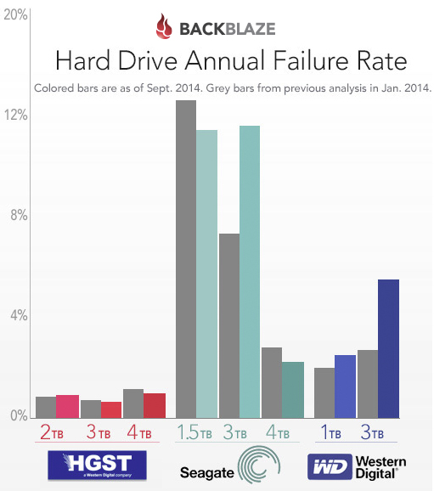
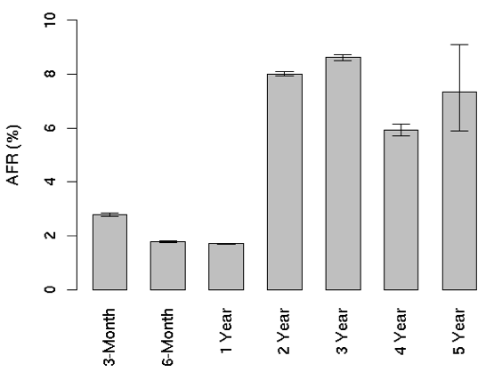
Disk Annual Failure Rate (AFR)
Hard drive fails all the time
Google: 2% ~ 9%
BACKBLAZE: 1% ~ 10+%
Reference
http://static.googleusercontent.com/media/research.google.com/en//archive/disk_failures.pdf
https://www.backblaze.com/blog/hard-drive-reliability-update-september-2014/

Slide 39
Qsan Fast Rebuild
Automatic rebuild
Hardware RAID Engine
Minimize system loading
Minimize performance impact
Average 50% time reduced
Lower risk exposure
Rebuilding Time
50% Off

Slide 40
Hard Drive Management
HDD Health Check: Check the HDD overall status of used HDDs or new HDDs
HDD Firmware Upgrade: when HDD vendors release major patches, upgrade all the HDD’s firmware online and at once

Slide 41
System Configurations
Auto Firmware Detection & Synchronization
Configuration Export
Backup the whole system’s configuration
Import configurations from other systems
Volume Restoration
Record every change done to the volume configurations
Auto Disk Spindown
More than 60% power saving
Enclosure Management
Smart and Easy
Pick the notification method you need and you’re good to go
Email, SNMP trap, Browser pop-up windows, Syslog, Windows Messenger, ……
Notes:
***

Slide 42
Qsan Volume Restoration
It is Scary when
Deleting the volumes
at the Wrong storage.
Qsan storage
Records Every Changes
done to the volume.
All the volume configuration histories are stored. Like a time machine, users can rollback to any configuration and to any particular time.
One Click to Restore

Slide 43
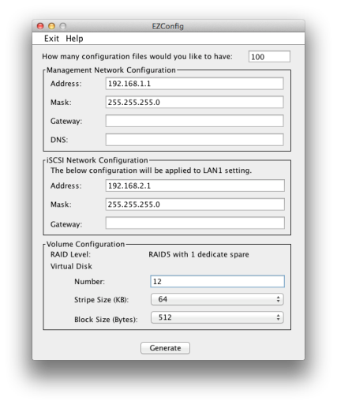
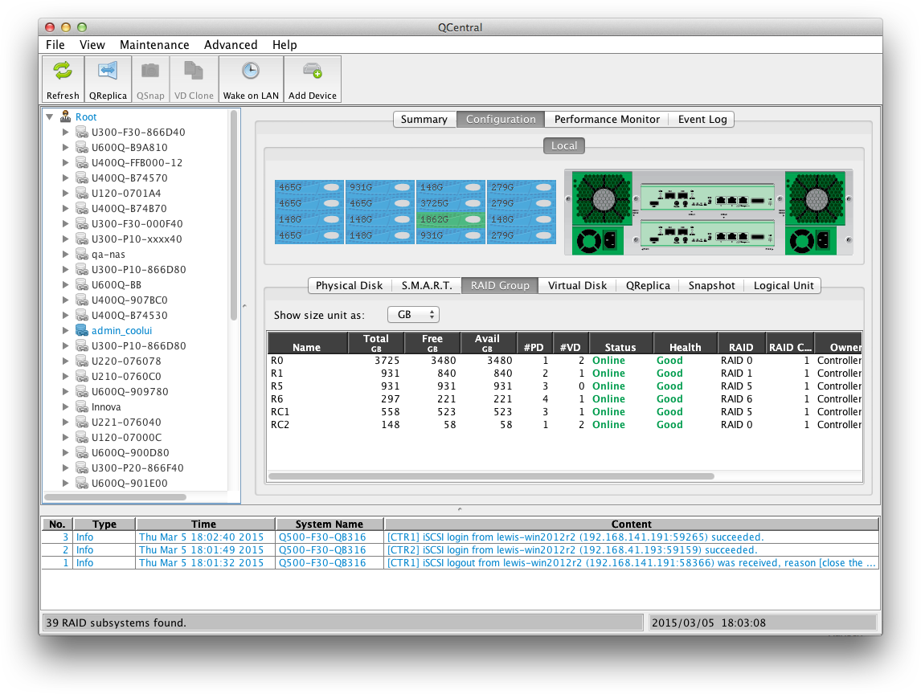
System Management
Easy to Use and Install
Quick Installation
Volume Creation Wizard
EZConfig
Configure the whole system at once
Create optimized volumes
Configure 250 systems at once
Multiple Approaches
to the Systems.
Central Management
Manage and Monitor all the systems
Web UI
Secure Telnet
LCD Module
USB LCM
Console
API

Slide 44
Interface & Networking
IEEE 802.3ad link aggregation (LACP), Trunking, MC/S and MPIO support
LACP/Trunking: Aggregate multiple network interfaces into a single logical bonded interface that correspond to a single IP address
MPIO MC/S: Provide multiple sessions / connections
Provide multi-path, failover, and load-balancing and when a network interface fails, the service and I/O won't stop and
Qsan Storage
MC/S
MPIO
LACP
Trunking
Switch
Server

Slide 45
Operating System & Compatibility
Various operating system support
Complete hard drive support
No expensive hard drive purchase bounding
SAS SATA SSD
Notes:
***

Slide 46
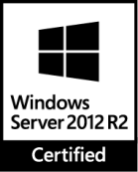
Virtualization
AegisSAN series support VMware, VAAI, Citrix and Hyper-V
VMware VAAI (vStorage APIs for Array Integration)
Offload server and network loading by reducing the redundant IO paths, overheads and server CPU cycles without impact on storage performance
Speed up provisioning of new virtual machines
Improve storage performance
Increase VM density

Slide 47
Outstanding Performance

Slide 48
Qsan AegisSAN Series Performance
AegisSAN
LX
AegisSAN
Q500
AegisSAN
V100
Dual Active
Controllers
Dual Active
Controllers
Single
Controller
10G iSCSI | 1G iSCSI | 16G FC | 8G FC | 10G iSCSI | 1G iSCSI | 16G FC | 8G FC | 10G iSCSI | 1G iSCSI | 16G FC
Throughput iSCSI Read 4000MB/s Write 2000MB/s FC Read 6600MB/s Write 3000MB/s | Throughput iSCSI Read 3400MB/s Write 1500MB/s FC Read 6300MB/s Write 2300MB/s | Throughput iSCSI Read 1300MB/s Write 720MB/s FC Read 3100MB/s Write 1500MB/s
IOPS Read 760K Write 500K | IOPS Read 320K Write 210K | IOPS Read 128K Write 120K

Slide 49
Built-in Turbo Performance
 | Qsan | Dell | IBM
 | AegisSAN LX | Q500 | V100 | PowerVault MD3600i MD3620i MD3660i MD3200i MD3220i MD3260i | V3700
Turbo Performance | Built-in | Optional | Optional
Fee | Free | ~ $2500 | $6850

Slide 50
Hardware Offload Engines 2.0
QiSOE | Qsan hardware iSCSI offload engine
QiSOE adopts a dedicated CPU core to process iSCSI packets
Write speed x1.5 times faster
fcQiSOE | Qsan hardware FC offload engine
fcQiSOE adopts a dedicated CPU core to process FC traffic
IOPS performance x1.6 times faster
1.5
1.6

Slide 51
SSD Caching
Performance x18 times
Reduce hard drive IO bottleneck
Lower latency
Match SSD performance to applications
Put your dollars where needed most
x18

Slide 52
Surveillance Application

Slide 53
Topics
Surveillance Trends in Storage
Exponential Data Growth
Challenges and Requirements
Qsan AegisSAN Storage
Case Studies

Slide 54
Surveillance Trends in Storage
IP/Networked-based HD video surveillance
Higher Resolution
Bigger Storage Capacity
4K
Notes:
http://www.ifsecglobal.com/video-surveillance-predictions-2015-beyond-game-changing-trends-technologies/

Slide 55
Exponential Data Growth
Same conditions
100 Cameras
30 Frame rate
14 Record Days
4CIF vs. 1080P

Slide 56
Challenges and Requirements
Challenges
Requirements
High resolution and high frame rate cameras
Expansion demands
Nonstop operating
Performance and bandwidth
Scalability
Reliability

Slide 57
Qsan AegisSAN Storage
Secure and Reliable
Deliver highly reliable surveillance solutions for midsize to large deployment.

Slide 58
Qsan AegisSAN Highlights
Uncompromised Performance
Flexible Expansion and Scalability from Midsize to Large Deployment
Direct to iSCSI Recording
High Availability
Advanced Data Protections
Easy Integration, Installation, and Management

Slide 59
Specifications | Performance | Scalability
AegisSAN
LX
AegisSAN
Q500
AegisSAN
V100
1000+ | 700 | 200
10G iSCSI | 1G iSCSI | 16G FC | 8G FC | 10G iSCSI | 1G iSCSI | 16G FC | 8G FC | 10G iSCSI | 1G iSCSI | 16G FC
2U12 | 3U16 | 4U24 | 4U60 | 2U12 | 3U16 | 4U24 | 3U16 | 4U24
Max 256 HDD | Max 256 HDD | Max 192 HDD
Max Enclosures No. 21x 2U12 | 16x 3U16 | 10x 4U24 | 4x 4U60 | Max Enclosures No. 21x 2U12 | 16x 3U16 | 10x 4U24 | Max Enclosures No. 16x 3U16 | 10x 4U24
Throughput iSCSI: 4000MB/s Read, 2000MB/s Write FC: 6600MB/s Read, 3000MB/s Write | Throughput iSCSI: 3400MB/s Read, 1500MB/s Write FC: 6300MB/s Read, 2300MB/s Write | Throughput iSCSI: 1300MB/s Read, 720MB/s Write FC: 3100MB/s Read, 1500MB/s Write
IOPS 760K Read, 500K Write | IOPS 320K Read, 210K Write | IOPS 128K Read, 120K Write
Dual Active
Controllers
Dual Active
Controllers
Single
Controller
1.5PB
1.5PB
1.1PB

Slide 60
……
200 Cameras
……
……
500 Cameras
……
……
……
700 Cameras
NVR
NVR
NVR
LAN
LAN
LAN
AegisSAN Q500Q-P20
Single Controller
12 HDDs / 44TB / RAID 5
Resolution: 720P
Retention: 14 Days
Requirement: 32TB
AegisSAN Q500Q-P20
Dual Controllers
12 HDDs / 44TB / RAID 5
JBOD J300Q-D424
24 HDDs / 88TB / RAID 5
Resolution: 720P
Retention: 14 Days
Requirement: 80TB
AegisSAN Q500Q-P20
Dual Controllers
12 HDDs / 44TB / RAID 5
JBOD J300Q-D424 x3
72 HDDs / 264TB / RAID 5
Resolution: 720P
Retention: 30 Days
Requirement: 240TB
Expansion
Even the original deployment plan was fully considered and arranged. The requirements are changing from time to time. When more cameras and NVR are installed, longer video duration are requested, or higher video quality is demanded, the storage systems must have the ability to expand easily and without impacting the service. Qsan AegisSAN storage systems are easily adjusted and expanded online for nonstop services.
Notes:
????

Slide 61
High Availability
Hardware
SANSoft
No single point of failure
Fully redundant components
Active-Active RAID controllers
Hot pluggable modular design
Cache mirroring
Automatic failover
Automatic management failover
Non-Disruptive upgrade
5 Minutes Downtime Per Year
99.999% Uptime

Slide 62
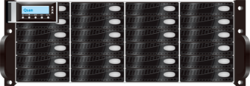
Direct to iSCSI Recording
Low
TCO
Recording
Management
Server
Replay
Client
……
……
……
IP Cameras
Main Path
Failover Path
Less
Management
LAN
Qsan AegisSAN iSCSI Storages
Dual Active Controllers
Up to 256 Disks
Reliable
Multipath

Slide 63
Advanced Data Protection
Enterprise Features
Integral Data Protections
Snapshot | Clone | Replication
Smart Data Management
Thin Provisioning
SSD caching
Fast rebuild
Seamless Roaming
Copy Migration
Snapshot
Clone | Mirror
Remote Replication
Thin Provisioning
SSD Caching
Fast Rebuild
Seamless Roaming
Copy Migration

Slide 64
Easy Integration, Installation, and Management
Integration
Management
Provide complete and full functions’ API for integration to your own management software
Build consistent UI & UX
Multiple interfaces
Web UI^{@HTTP @HTTPS}, Console, SSH, Central Management, Quick Finder

Slide 65
Easy Integration, Installation, and Management
Easy Configuration
Configure 250 Systems At Once
Install With USB
Wait 3 Seconds & Reboot
TADA!!

Slide 66
Case – City Surveillance
Surveillance Node
Surveillance Node
Surveillance Node
Surveillance Node
Surveillance Node
Surveillance Node
Private Network
Private Network
Private Network
Video
Management
Server
City Command Center
Video
Management
Server
Web & Media
Streaming
Center
Surveillance
Management
Server
Database
Server
Area Sub-Center
Area Sub-Center
80+ Q500-P10-D316 Deployed | 1600 IP HD Cameras | 6000TB Capacity for 30 Days Retention

Slide 67
AegisSAN Values & Benefits

Slide 68
AegisSAN LX
Application Optimized Performance
AegisSAN LX series are optimized for different applications, IO sizes, and access patterns.
AegisSAN LX can deliver more than 600K random IO per second for high IOPS demands and stable 6,200MB/s for substantial performance requirements.
610K
400K
512B QD32 x 8 Workers

Slide 69
AegisSAN LX
Diverse Host Connection Support
10G iSCSI | 1G iSCSI | 16G FC | 8G FC
Various Chassis Choices for Any Unexpected Expansion
2U 12 Bays | 3U 16 Bays | 4U 24 Bays | 4U High Density 60 Bays
Enterprise Software Features
Integral Data Protections
Snapshot | Clone | Replication
Smart Data Management
Thin Provisioning
SSD caching
Fast rebuild
Seamless Roaming
Copy Migration
99.999% Uptime &
Fully Redundant Design
Our fully redundant design eliminates single-points-of-failure. AegisSAN LX arrays have active-active controllers for high performance and failover, hot swappable drives, power supplies and fans.

Slide 70
AegisSAN Q500
Optimized Throughput
AegisSAN Q500 series are optimized for demanding high-throughput applications. It can deliver more than 6,000MB/s for throughput requirements.
6,200
6,300

Slide 71
AegisSAN Q500
Energy Efficiency
AegisSAN Q500 series adopt power efficient CPU, 80+ Gold PSU, smart enclosure management firmware, and disk auto spindown technologies for more than 60% power saving.
Enterprise Software Features
Integral Data Protections
Snapshot | Clone | Replication
Smart Data Management
Thin Provisioning
SSD Caching
Fast rebuild
Seamless Roaming
Copy Migration
USB LCD Module
#Security #EasyManagement
Qsan innovated patent filing USB LCM can avoid data leakage in data centers and lower IT management effort.

Slide 72
AegisSAN V100
Surveillance
AegisSAN V100 series are designed for Video Surveillance requirements. It can support up to 200 HD IP cameras real-time recording.
Enterprise Software Features
Integral Data Protections
Snapshot | Clone | Replication
Smart Data Management
Thin Provisioning
SSD Caching
Fast rebuild
Seamless Roaming
Copy Migration
Host Connection Support
10G iSCSI | 1G iSCSI | 16G FC | Hybrid
Best Scalability for Unexpected Expansion
3U 16 Bays | 4U 24 Bays
Up to 192 Hard Drives Per System

Slide 73
Qsan
Storage Solutions
High Availability 99.999% Uptime
Our fully redundant design eliminates single-points-of-failure. AegisSAN LX/Q500 arrays have active-active controllers for high performance and failover, hot swappable drives, power supplies and fans.
Optimized Performance
AegisSAN series are optimized for different applications, IO sizes, and access patterns. AegisSAN series are designed for demanding high-throughput applications.
Built-in Enterprise Software
AegisSAN series protect your data under any circumstances without extra charge.
Notes:
Icons: http://icons8.com/

Slide 74
Awards

Slide 75
Qsan TrioNAS Series Technical Introduction

Slide 76
Qsan NAS product line
Price
Qsan
NAS
TrioNAS LX
U400/U600
U300
TrioNAS
U120
U210
Ctrl HA
Full redundant
CPU grade
Scale-up (JBOD)
SAS-enabled
Ctrl pluggable
Cabless backplane
CPU grade

Slide 77
Customer environment 1/3
Application servers
SQL
Servers
Exchange
Servers
Employee
desktops & notebooks
SMB, NFS, AFP, iSCSI, FC
Windows
Servers
Linux
Servers
Unix
Servers
backup
Servers
backup
Servers
File servers
Cold storage
Notes:
File server (file sharing environment), the sharing center
Goal : all different clients (windows, mac, linux, unix, mobile devices) can share files with each other efficiently
each client can put its files on U300 and share with other clients

Slide 78
Customer environment 2/3
iSCSI
SAN switch
1GbE
LAN
FC SAN
switch
SAN environment
NAS environment
Notes:
Define unified storage environment

Slide 79
Customer environment 3/3
VMware Ready, Hyper-V, Citrix Ready certified
Support iSCSI and Fibre Channel block storage for hypervisors
Use deduplication and thin provisioning to gain maximum storage efficiency for VDI application
Server virtualization for storage consolidation
iSCSI, FC, NFS, SMB
VM
VM
VM
VM
Notes:
Virtualization environment

Slide 80
Instant readiness
Start I/O right after share or LUN is created
Fast rebuild time
Intelligent resilvering
Only rebuild actual data blocks
The less the data, the faster it takes
Formatting
Volume initialization
Long rebuilding
TrioNAS LX U300
(ZFS)
Setup wizard (pool->share)
Connect NAS share
Copy a 8GB video
Editing a video
0min 1min 2min 3min 4min 5min 10min
Setup wizard (pool->share)
Formatting
Formatting
Formatting
Connect NAS share
Other NAS
(Ext3,Ext4)
Notes:
No need for RAID initialization (parity)

Slide 81
Easy management
Web browser interface
clear, simple management
QCentral (Java-based)
centralized monitoring, intuitive management

Slide 82
ZFS benefits – Break bottlenecks
Storage size is ever- increasing
Storage efficiency is low
Data integrity and data protection become more critical
Data management costs are high
Notes:
As hard drive size grows larger and larger. FS needs to scale up as well.
Inefficiency: stranded space, linear-time create, fixed block size, naïve prefetch, painful RAID rebuild time, growing backup time
No defense against silent data corruption: any defect in the IO path (disk, cable, disk, driver, firmware) can corrupt data undetected! Like running a server without ECC memory
As disk becomes larger, bit error rate becomes inevitable. (CERN research paper)
different tools to manage file, block, partitions, volumes, RAID groups

Slide 83
ZFS benefits - Highlights
More than just another FS : file system + volume manager + RAID controller all in one
Immense scalability : 128bit address space
End-to-end data integrity
Everything is copy on write, always on disk consistent
Everything is transactional
Everything is checksumed, no silent corruption, no bad metadata
Enhanced data protection : snapshot, replication, pool scrubbing
Storage efficiency
Thin provisioning, deduplication, compression
Simple administration
Notes:
ZFS: means the last word of file system (the ultimate file system). Z is the last alphebat.
ZFS solves the 4 majors headaches of modern file systems. (the first slide of ZFS)

Slide 84
ZFS benefits - Comparison
 | ZFS | Ext4 | NTFS | HFS+
Address bits | 128 | 48 | 64 | 32
File system type | Transactional | Journaling | Journaling
Max volume size | 16 EB (2⁶⁴) | 1 EB(2⁶⁰) | 16 EB | < 8EB
Max file size | 16 EB (2⁶⁴) | 16 TB | 16 EB | < 8EB
Max # of files | 2⁴⁸ | 2³² | 2³²
Max filename length | 255 bytes | 255 bytes | 255 bytes | 255 bytes
License type | GDDL, CDDL | Open source | Proprietary
Metadata checksum | Yes | Yes | No | No
Variable block size | Yes | No | No | No
Copy On Write | Yes | No | No | No
Snapshot | Yes | No | Yes | No
Hot spare | Yes | No | No
RAID5, RAID6 | Yes | No | No | No
Defragmentation | No | Yes | Yes
Compression | Yes | No | Yes
Deduplication | Yes (block level) | No | No(Yes, file level) | No
Encryption | Yes | No | Yes | No
Notes:
Various Linux file system comparison

Slide 85
ZFS benefits – Copy on Write
All or nothing, always on-disk consistent
Immune to power failure
Notes:
Copy-on-Write technology

Slide 86
ZFS benefits – Silent corruption
Other filesystems
ZFS
Pointer
Pointer
Data
Data
Checksum
Checksum
● ● ●
Checksum
Checksum
Pointer
Pointer
Checksum
Checksum
Checksum in data block
Disk block checksum only validate media
Can only detect bit error
Data
Data
Checksum and data are separated
Hierarchical checksum tree to validate the entire IO path
Can detect any form of silent data corruption
Notes:
Not available from other filesystems
Only possible when combining
Integrated volume manager
Large checksums. Checksum is saved at pointer, not with data
Detect and correct silent data corruption

Slide 87
ZFS benefits – Self healing
1.
Application
2.
Application
3.
Application
ZFS mirror
ZFS mirror
ZFS mirror
1.
2.
3.
Application
Application
Application
ZFS RAID5
ZFS RAID5
ZFS RAID5
⊕
Notes:
1. Application issues a read. ZFS mirror tries the first disk. Checksum reveals that the block is corrupt on disk.
2. (RAID 0) ZFS tries the second disk. Checksum indicates that the block is good.
(RAID 5) ZFS uses the parity block to recover the error block.
3. ZFS returns known good data to the application and repairs the damaged block.

Slide 88
Storage pool, Share, Volume
iSCSI
Fibre Channel
Host interface
Share2
LUN1 … LUNn
LUN1 … LUNn
Share1
Volume1
Volume2
Share/Volume
Storage pool
RAID set 1
RAID0
RAID set 2
RAID5
Hard spare
dedicated
RAID set m
RAID5
Hard drives
Local enclosure
Expansion enclosure(JBOD)
Notes:
the structural concept (bottom-up relationship) of HDD, storage pool, share and volume.
- Hard drives in pool can extend across different enclosures
RAID sets in the same pool can be in different RAID levels
Dedicated hot spare (not global, EMC VNXe is not global spare either)
From pool, users can create folders for shares and volumes for iSCSI LUN and FC LUN
A LUN# needs to be attached to the volume to be accessed by either iSCSI or FC
A volume can be attached to several LUNs
A volume can only be assigned to either iSCSI interface or FC interface

Slide 89
Storage pool
Flexibility & Scalability
Different types of RAID sets in the same group
Up to 512 pools, up to 192 HDDs in one pool
Security
Password protected locking mechanism
Pool 1
Pool n
RAID set 1
RAID0
RAID set 2
RAID5
Hard spare
dedicated
RAID set m
RAID5
RAID set
RAID6
Local enclosure
Expansion enclosure(JBOD)
Notes:
Importing pool by password checking
Problematic pools (failed) will not be imported. But it will be displayed for warning and admin verification.
Online pool expansion by adding more RAID sets
Offline pool roaming (move HDDs to a different array enclousure)

Slide 90
RAID set
Support RAID 0, 1, 5, 6, 10, 50, 60
Dedicated hot spares (RAID sets in the same pool)
Auto rebuilding
Online RAID expansion (e.g. 2TB*4 -> 4TB*4)
Instant readiness (no RAID initialization, fast resilvering)
Hot swappable disk drives
Pool
RAID set 1
RAID5
RAID set 2
RAID5
Hard spare
dedicated
RAID set m
RAID6
Notes:
In ZFS, RAID-Z equals RAID5 (1 redundancy)
RAID-Z2 equals RAID6 (2 redundancy)

Slide 91
Hybrid storage pool – SSD caching
ST3600057SS SAS
12x pcs
600GB 15K rpm
Intel S3500 SSD
4x pcs 240GB
ST33000650NS SATA
8x pcs 3TB 7.2K rpm
18x
3x
12%
48%
10%
Read IOPS Write IOPS Cost Power (Watts) Capacity
Notes:
SSD caching – random read performance improvement (use QA test data)
Hybrid benefits will become apparent in economic scale. Don’t compare like 1 SSD + 3 SATA vs 4 SAS.
U300 with Intel Xeon E3-1225V3 / DDR3 ECC 32GB / ZFS (ZOL)
SSD + SATA >= SAS
Benefits : cost down, energy down, capacity up
ST3600057SS(SAS) : USD260
ST33000650NS(SATA) : USD190
Intel S3500 SSD 240G : USD300
(260*12-(190*8+300*4))/(260*12) = 12%
ST3600057SS(SAS) : 16W
ST33000650NS(SATA) : 10W
Intel S3500 SSD 240G : 5W
(16*12-(10*8+5*4))/(10*8+5*4)=

Slide 92
SSD caching
Improve random read/write IOPS over 20x times
Support up to 6x SSD drives per storage pool (4x read, 2x write)
Support RAID 1 for write cache
Performance boost for all shares/LUNs
Applications
ZFS
Cache hit!!
L2ARC
ZIL
Storage pool
Read cache
Write
cache
Notes:
Read cache (L2ARC)
Allow multiple SSD drives to form a large cache device to balance out the best read performance
Write cache (ZIL)
To speed up logging mechanism for synchronous writes. Allow multiple SSD drives to form a RAID 0 or RAID 1 log device.

Slide 93
SSD caching
U300 E3-1225v3 + 32GB RAM
4x Seagate 12Gb SAS SSD ST400FM0053
12x Seagate ST500NM0001 SATA 6Gb
4KB 100% Random Read
With SSD : 21314 IOPS
Accelerate random IOPS for file access and block access
Each storage pool has its own SSD read cache and SSD write cache. All volumes and LUNs in the same pool can benefit from SSD cache.
RAID 1 support for write cache
SSD cache is hot swappable
> 20x
Without SSD: 330 IOPS
1x
SSD cache OFF
SSD cache ON
Notes:
U300 E3-1225v3 + 32GB RAM
4x Seagate 12Gb SAS SSD ST400FM0053
12x Seagate ST500NM0001 SATA 6Gb
4KB 100% Random Read
Without SSD : 330 IOPS
With SSD : 21314 IOPS

Slide 94
Backup with deduplication
Deduplication benefits the most when using in regular full copy of data backup
Save up to 90% of storage space
Hosts using the backup storage still see multiple copies
1st
2nd
3rd
Differential data
Notes:
(data from Dell)
Data types Data redundancy(space saving)
Backup data (data archive) 85~95%
VMware VMs 50~90%
Database backup 45~70%
Home directories 20~50%
Email archive 20~40%

Slide 95
Compression
Lossless
Block-level, inline real time operation
LZJB algorithm : lossless and good balance between speed and efficiency
Both files and LUNs can be compressed
Efficient and almost no performance impact
Original
Restored
Compressed
Lossy
Original
Restored
Compressed
Notes:
LZJB: lossless data compression algorithm invented by Jeff Bonwick (ZFS project lead in Sun) to compress crash dumps and data in ZFS. It includes a number of improvements to the LZRW1 algorithm, a member of the Lempel-Ziv family of compression algorithms.
GZIP (1~9) has better compression ratio, but it takes longer time.

Slide 96
Directory services
Support Windows Active Directory
Support Lightweight Directory Access Protocol (LDAP)

Slide 97
UnifiedAUTH is simple
All data services (CIFS, FTP, AFP, iSCSI, webDAV) adopt the same set of account & password for authentication.
No more – forgot password?
with Domain or Local accounts
iSCSI CHAP
iSCSI CHAP
Notes:
Integrate iSCSI CHAP account into NAS account system.
**

Slide 98
Windows ACL support
Support Windows ACL.
Set folder access permissions in Windows environments
read
read,modify

Slide 99
File-level snapshot
Simple and easy to recover valuable files from virus attack or accidental deletion and modification.
Copy-on-write technology to record differential data only
Support rollback and clone functions
Support scheduled tasks
Support up to 4096 file-level snapshots
T₁
T₂
Now

Slide 100
Block-level snapshot
Simple and easy to protect valuable data
Copy-on-write technology to record differential data only
Support rollback and clone functions
Support scheduled tasks
Support up to 4096 block-level snapshots
LUN 1
T₁
T₂
Now
LUN 2

Slide 101
Backup – Rsync
Rsync client : replicate files to any devices that support rsync server
Rsync server : TrioNAS U300 can act as a destination for any rsync-compatible device to set up connection
Support up to 16 replication tasks
Connection is established through SSH protocol
TrioNAS LX
TrioNAS LX
TrioNAS
Rsync-compatible devices
Notes:
Rsync is a file synchronization and file transfer utility for linux systems. It minimizes network data transfer by using a form of delta encoding called rsync algorithm.

Slide 102
Backup – Replication
Block-level replication using copy-on-write snapshot technology
Efficient differential data replication
Same technology for file and block data
Support up to 16 replication tasks
Connection is established through SSH protocol
TrioNAS LX
TrioNAS LX
TrioNAS
ZFS storage devices
Notes:
Efficient and secure

Slide 103
Amazon S3 backup
Backup folders and files to public cloud storage
Allow scheduled tasks and folder synchronization

Slide 104
VMware support
VAAI for iSCSI
Full copy (hardware assisted)
Write zeroing (hardware assisted)
Hardware assisted locking
(under development) Thin provisioning and space relaim
VAAI for NAS
>> Under development <<
Notes:
U300 Fibre Channel model does not support VAAI.

Slide 105
Thank You

